Slide 1
CORNELL POLICE Phishing, Scams, and Extortion
2015-FEBRUARY 2022
data current as of 3.2.2022
Crime Analysis – Shelagh Dorn; and Investigator Chuck Alridge

Slide 2
CUPD Phishing, Scams, and Extortion Incidents 2015-FEB 2022
178 incidents examined from 2015 to February 2022
Campus cases are likely to be underreported
One incident can reflect multiple interactions, and consecutive losses, to scammers
Recent successful scams spoof Cornell email addresses and appear to be from authoritative sources (e.g. deans, department chairs)

Slide 3
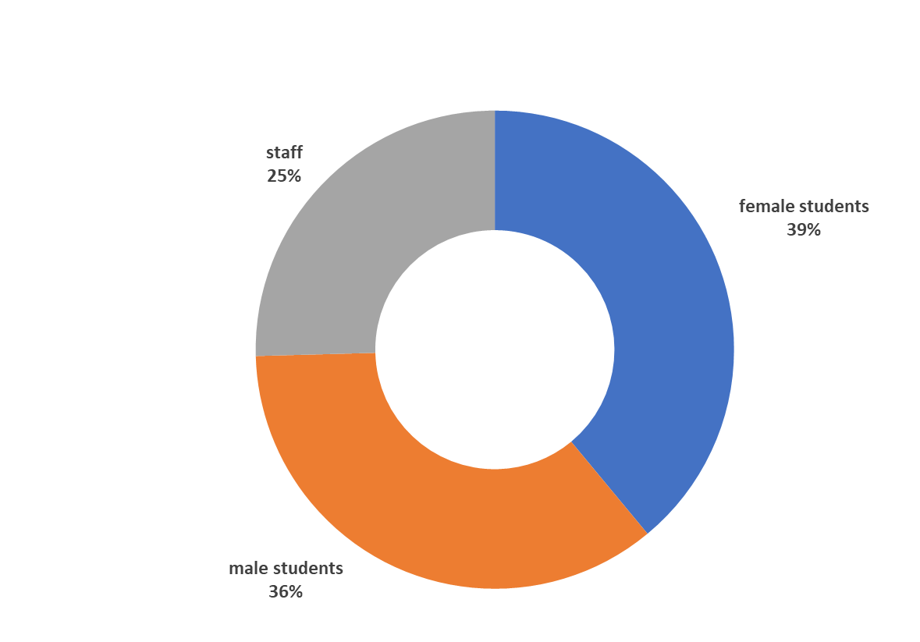
Victim/Target Percentages Based on Reported Incidents

Slide 4
VARIETY and PREVALENCE OF SCAMS IDENTIFIED

Slide 5
SCAM DESCRIPTIONS
Arrest Scam: The IRS; federal, state, or local police; international/federal authorities; NY State Taxation and Finance; or Chinese Police contact you to tell you they have a warrant for your arrest, or evidence you have committed a serious crime. In order to avoid prosecution or extradition, you are encouraged to send money to remain free.
One Chinese extortion scam, a virtual kidnapping, resulted in a victim paying the equivalent of about $.5 million.
Fraudulent check / Money order: This scam appears in various formats, but you are asked to cash a check or purchase prepaid cards and forward the card details or a portion of the cash to the requestor or an account. *Recent iterations make the request appear to be from an authority figure or a supervisor.*
Compromising video/pictures: Campus reports indicate that males are the primary victims of this scam, in which individuals IM or DM the subject, engage in enticing conversation, and request sexually explicit videos or pictures. Once the deeds are carried out, the subject is notified that the material will be released publicly to friends and family unless money is paid.
Sales fraud scams: You list a computer or other item for sale on Craigslist, Paypal, eBay, or Marketplace; when you ship the item, a buyer sends you payment which turns out to be fraudulent.
Job fraud: Seemingly legitimate job or research postings require personal information, which is readily provided by the victim being “hired.” Individuals are then asked to send money, cash fraudulent paychecks, or open accounts for their “employer” which then is used to scam others.
Apartment rent scams: Individuals seeking city sublets or apartments are scammed out of significant money.

Slide 6
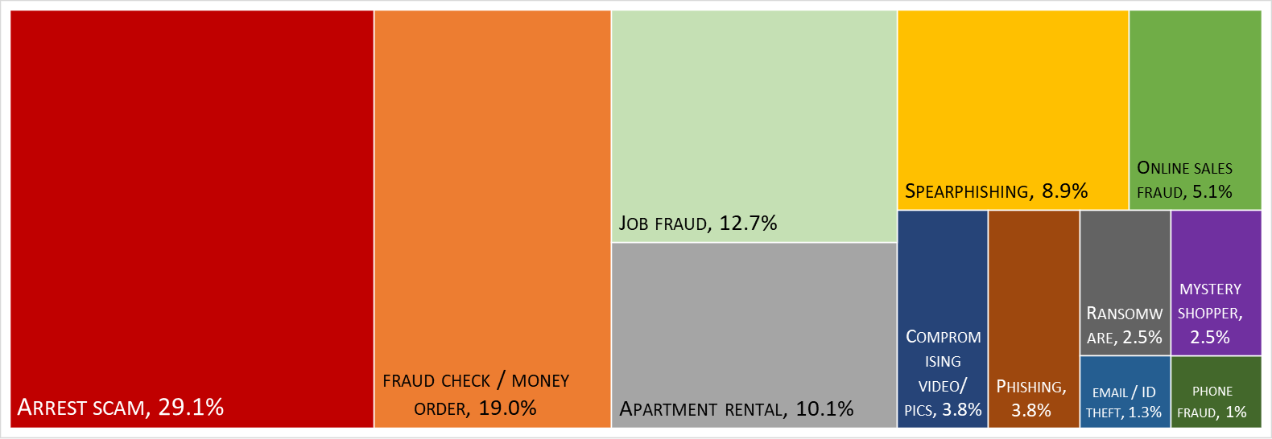
Most Successful Cornell Extortion Categories
Of the 178 cases reported to CUPD:
44% of money extortion attempts are successful (n=79)
25% result in personal identity details revealed

Slide 7
of Victims who could be identified as International Students . . . .
Certain populations appear to be more vulnerable to arrest scams and job-related fraud, especially when the sender appears to be an authority figure.
In several cases, targeted individuals were identified by their advisors or by other confidants and referred to Cornell Police.
Despite referrals, several individuals did not want to file an official report.
Specific training - including examples of scams, spearfishing, and cold calls requesting personal information - might diminish the success of scammers targeting Cornell students and employees.

Slide 8
CORNELL POLICE A Review of Phishing, Scams, and Extortion
2015-FEBRUARY 2022

