Slide 1
Cornell University Police Bicycle Theft Analysis
January 1, 2020-June 1, 2023

Slide 2
Analysis
Thefts are most prevalent from North Campus dorms (Dickson, Hu, and Donlon) and RPCC
On Central Campus: Milstein and Carpenter Halls and Uris Library
On West Campus, Becker House
170 thefts of unsecured and secured bikes occurred
Averages 5 bikes per month (6 bikes/month during the 2022-2023 school year)
Most secured bikes that were stolen had cable locks that were easily cut
Some secured bikes were stolen from bike rooms
On average, bikes that were reported stolen were unchecked for about 48 hours*
During the 2022-2023 school year, the 57 bikes stolen were unchecked for 69 hours* on average
*outliers were removed from this analysis, including one bike that was stolen at some point during nine and a half months; and twenty-two bikes that had a start and end date/time of less than 12 minutes.

Slide 3
Bicycle Theft Totals, by First Day of Occurrence JAN 2020-MAY 2023
Without a more accurate start date, prevalence of theft appears to be relatively distributed throughout the week; with Friday (38) and Wednesday (27) appearing to be more popular days for theft.
Temporal analysis (by hour) could not be performed because most bikes were left for prolonged periods of time.
# = 170

Slide 4
LOCATIONS WITH 3 OR MORE BIKE THEFTS
JAN 2020-JUN 1, 2023

Slide 5
BIKE THEFT HEAT MAP, Jan 2020-Jun 1, 2023

Slide 6
BIKE THEFT MAP with GRADUATED SYMBOLS, Jan 2020-Jun 1, 2023

Slide 7
August 2022-May 2023 bike thefts
Data mapping that highlights August 2022-May 2023 bike thefts indicates that Central campus/Engineering Quad & the Statler and Ho Plaza areas experienced a concentration of the 57 bike thefts during the 2022-2023 school year.
(Hu Hall is the orange dot on North Campus.)

Slide 8
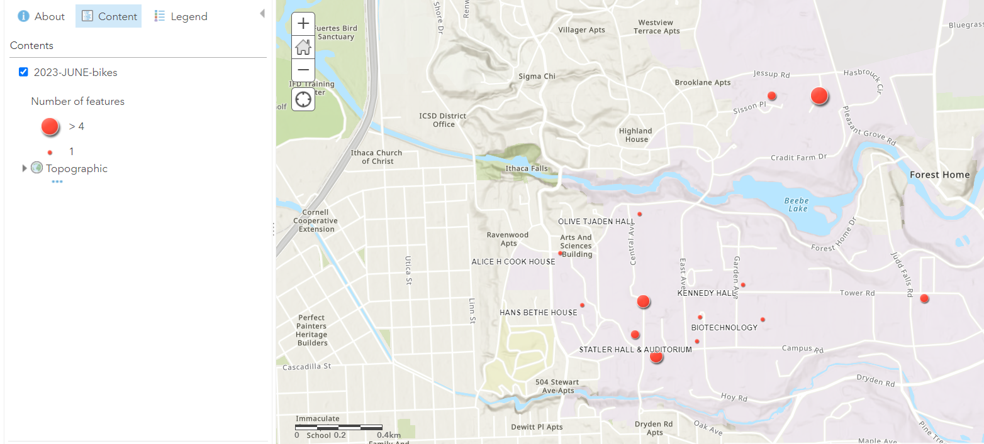
BIKE THEFTS, SPRING SEMESTER JAN 1-JUN 1 2023

Slide 9
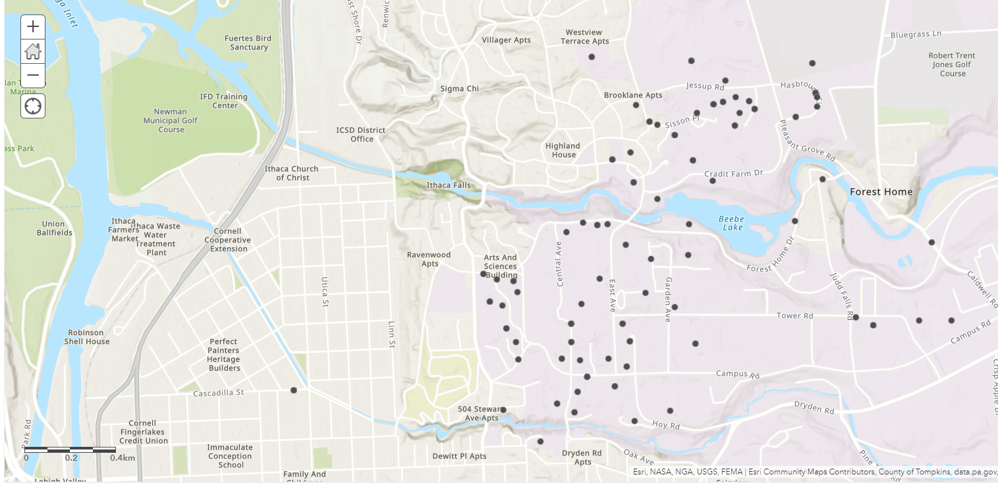
An example of data “Pin Mapping” from Jan 2020- Jun 1, 2023.
You can see that pin mapping masks the locations where multiple bicycles have been stolen.

Slide 10
Cornell University Police 2.5 Years of Bicycle Theft Analysis
January 1, 2020-June 1, 2023
Shelagh Dorn, PhD
Cornell Public Safety - Analysis

